Slide 1
MSSQL okiem DBA
Łukasz Herman
Referencje:
Ponad 22 tysięcy baz danych (rok temu było 13 tys.)
Kilkadziesiąt instancji SQL (74 na chwilę obecną)

Slide 2
Halo! Deadlock? - czy są u mnie deadlocki i co mamy za darmo?
SQL clusters at scale (scale out or up?) - czyli jak postawić kilkadziesiąt klastrów w ciągu dniówki i się nie pomylić.
Query plan warnings - za co gonić programistów?
Query store - jak podejść do tematu w zautomatyzowany sposób?

Slide 3
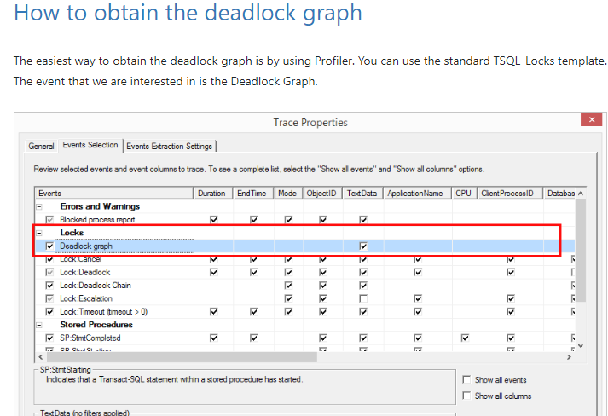
https://www.sqlshack.com/understanding-graphical-representation-sql-server-deadlock-graph/
There are multiple ways to go about troubleshooting deadlocks which include:
Trace flags 1222, 1204
Profiler (trace events)
Extended events

Slide 4
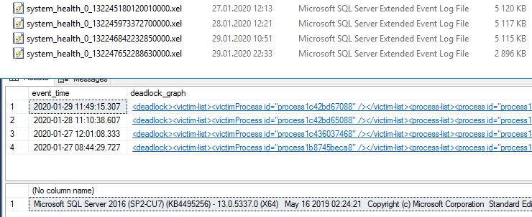
Extended Events (>SQL 2012)

Slide 5
SELECT TOP 100
DATEADD(mi, DATEDIFF(mi, GETUTCDATE(), GETDATE()), XEvent.value('(@timestamp)[1]', 'datetime')) AS event_time, XEvent.query('(data/value/deadlock)') AS deadlock_graph
FROM
(
SELECT CAST(event_data AS XML) as [target_data]
FROM sys.fn_xe_file_target_read_file('system_health_*.xel',NULL,NULL,NULL)
WHERE object_name like 'xml_deadlock_report'
) AS [x]
CROSS APPLY target_data.nodes('/event') AS XEventData(XEvent)
--WHERE XEvent.value('(@timestamp)[1]', 'datetime') >= '2019-09-23 15:12:15.393'
ORDER BY event_time DESC

Slide 6
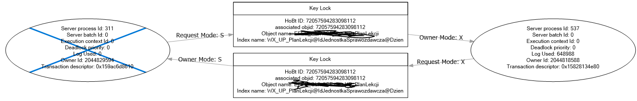
Prosty deadlock

Slide 7
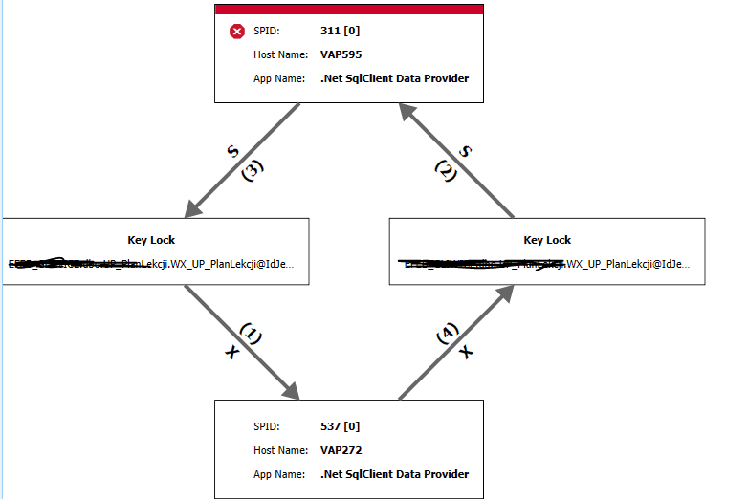
Prosty deadlock
Hint: https://www.sentryone.com/plan-explorer

Slide 8
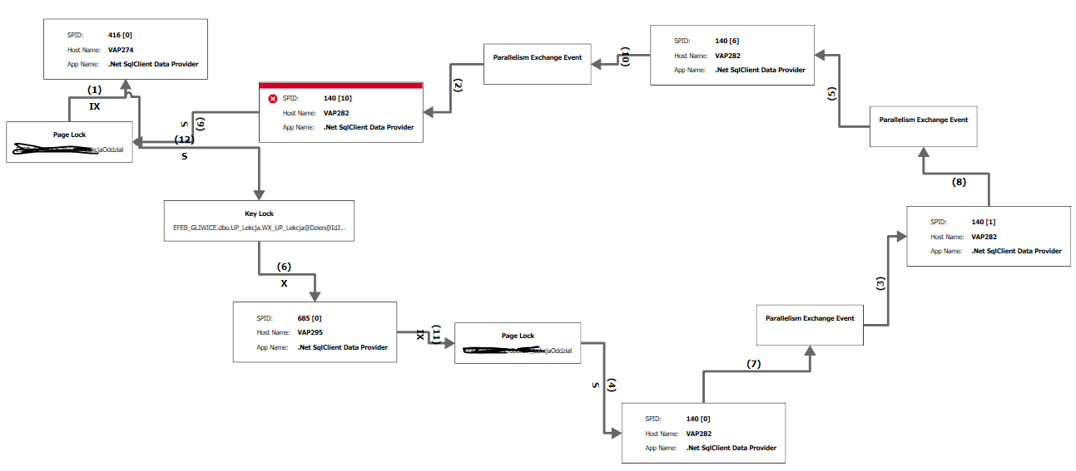
Mniej prosty deadlock

Slide 9
Demo 1
SQL Sentry Plan Explorer
Skrypt PSh
Mail

Slide 10
SQL Clusters at scale Jak postawić kilkadziesiąt klastrów w ciągu dniówki i się nie pomylić
Hint: Sharding https://docs.microsoft.com/en-us/azure/architecture/patterns/sharding

Slide 11
550..570 | ForEach-Object { $LABConfig.VMs += @{ VMName = "DB$($_)A" ; ParentVHD = $win2019core; HDDNumber = 1; HDDSize= 64GB ; VMProcessorCount = 4 ; MemoryStartupBytes= 8192MB ; StaticMemory = $True ; CsvPath = $csv ; VLAN = $vlanAPP ; CustomPowerShellCommands=` $rdp, ` $telnet,` $rdpFirewall }}
Pierwsze primo: IaaC
(Infrastructure as a Code)
Hint: https://github.com/microsoft/WSLab

Slide 12
; Specifies a Setup work flow, like INSTALL, UNINSTALL, or UPGRADE. This is a required parameter. ACTION="InstallFailoverCluster" ; Specifies that SQL Server Setup should not display the privacy statement when ran from the command line. SUPPRESSPRIVACYSTATEMENTNOTICE="True" ; By specifying this parameter and accepting Microsoft R Open and Microsoft R Server terms, you acknowledge that you have read and understood the terms of use. IACCEPTROPENLICENSETERMS="True" ;FEATURES=SQLENGINE,REPLICATION,FULLTEXT,DQ FEATURES=SQLENGINE,REPLICATION ;INSTANCENAME="SQL2016A" INSTANCENAME="BASE_INSTANCENAME" ;INSTANCEID="SQL2016A" INSTANCEID="BASE_INSTANCENAME" ;FAILOVERCLUSTERIPADDRESSES="IPv4;DHCP;Cluster Network 1" FAILOVERCLUSTERIPADDRESSES="IPv4;DHCP;BASE_CLUSTERNETWORK" ;FAILOVERCLUSTERNETWORKNAME="SQL01A" FAILOVERCLUSTERNETWORKNAME="BASE_FAILOVERROLENAME"
Drugie primo:
Instalacja nienadzorowana – pliki odpowiedzi
Hint: https://github.com/microsoft/WSLab

Slide 13
New-PSDrive -Name U -PSProvider filesystem -Root ${configurationPath} -Credential $Credential | Out-Null Push-Location | Out-Null Set-Location 'U:\' [string]$passwordUser4Sql = [System.Runtime.InteropServices.Marshal]::PtrToStringAuto([System.Runtime.InteropServices.Marshal]::SecureStringToBSTR($passwordUser4Sql)) [string]$passwordUser4SqlAgent = [System.Runtime.InteropServices.Marshal]::PtrToStringAuto([System.Runtime.InteropServices.Marshal]::SecureStringToBSTR($passwordUser4SqlAgent)) $installCmd = "$setupPath /Q /SQLSVCPASSWORD='$passwordUser4Sql' /AGTSVCPASSWORD='$passwordUser4SqlAgent' /ConfigurationFile=""$configFile"" /IAcceptSQLServerLicenseTerms $updatePath" Invoke-Expression $installCmd Pop-Location | Out-Null Remove-PSDrive U
Trzecie primo:
Powershell

Slide 14
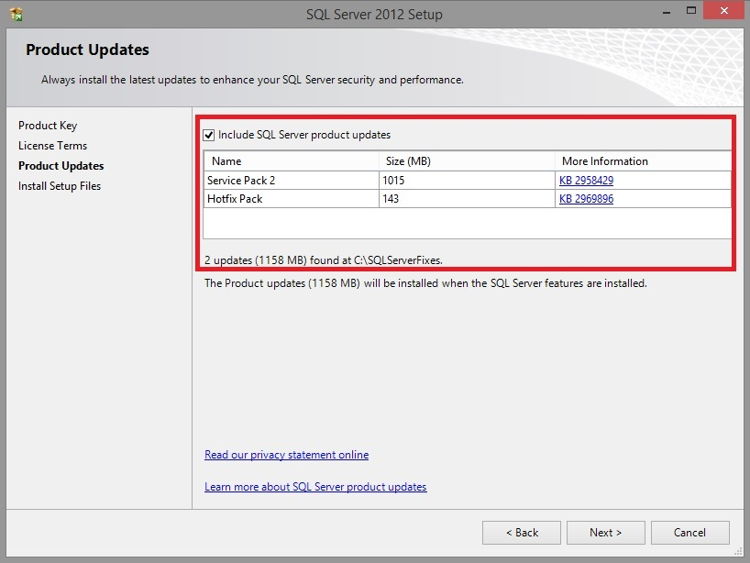
Czwarte primo:
Powtarzalność i CU
Hint: https://www.sqlshack.com/slipstreaming-sql-server-2012-2014/

Slide 15

Demo 2
Uwaga, dużo powershella

Slide 16

Query plan warnings

Slide 17
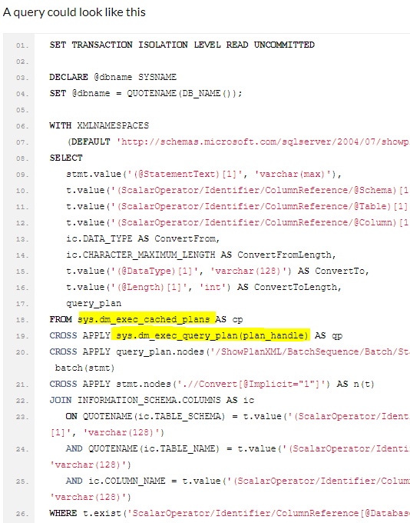
Implicit conversion
http://sqldeveloper.dk/blog/find-implicit-conversions/

Slide 18

Query store
Czy w ogóle da się automatyzować?

Slide 19
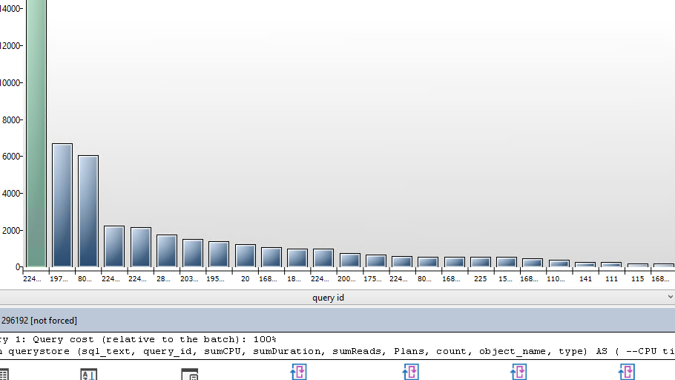
Query Store

Slide 20
Query Store - first aid kit query
--CPU time for whole database
SELECT
MAX(qt.query_sql_text) as sql_text,
q.query_id,
-- Microseconds to miliseconds
CAST(SUM(rs.avg_cpu_time*rs.count_executions)/1000 AS decimal(16,0)) as sumCPU, -- CPU
CAST(SUM(rs.avg_duration*rs.count_executions)/1000 AS decimal(16,0)) as sumDuration, -- Duration
CAST(SUM(rs.avg_logical_io_reads*rs.count_executions)/1000 AS decimal(16,0)) as sumReads, -- Logical reads
COUNT(1) as Plans,
SUM(rs.count_executions) AS Count,
max(so.name) as object_name,
max(so.type) as type
FROM
sys.query_store_query_text qt JOIN
sys.query_store_query q ON qt.query_text_id = q.query_text_id JOIN
sys.query_store_plan p ON q.query_id = p.query_id JOIN
sys.query_store_runtime_stats rs ON p.plan_id = rs.plan_id JOIN
sys.query_store_runtime_stats_interval rsi ON rsi.runtime_stats_interval_id = rs.runtime_stats_interval_id LEFT JOIN
sysobjects so on so.id = q.object_id
WHERE rsi.start_time >= DATEADD(HOUR, -24, GETUTCDATE())
group by q.query_id

Slide 21
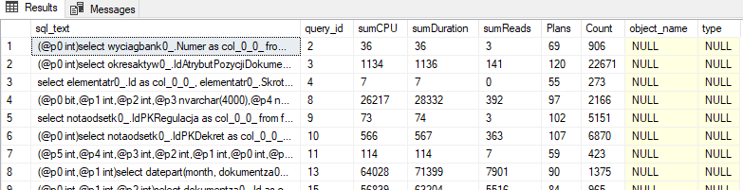
Query Store - first aid kit query

Slide 22
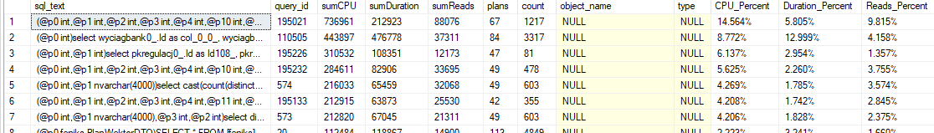
Query Store - first aid kit query

Slide 23
Query Store script
https://github.com/lukaszherman/datacommunity2020

Slide 24

https://github.com/lukaszherman/datacommunity2020

